Slide 1
PROJET DEVLAB FRONT
PORFOLIO-EHRSAM LUCIE

Slide 2
SOMMAIRE
01
02
03
Site
Mineure
Conclusion
Présentation & description du site, de la création de la maquette, à son intégration et la mise en ligne.
Présentation & explication de la mineure, et les compétences acquises et comprises.
Interêts et points forts de la mineure.

Slide 3
01
Présentation du Site
You can enter a subtitle here if you need it

Slide 4
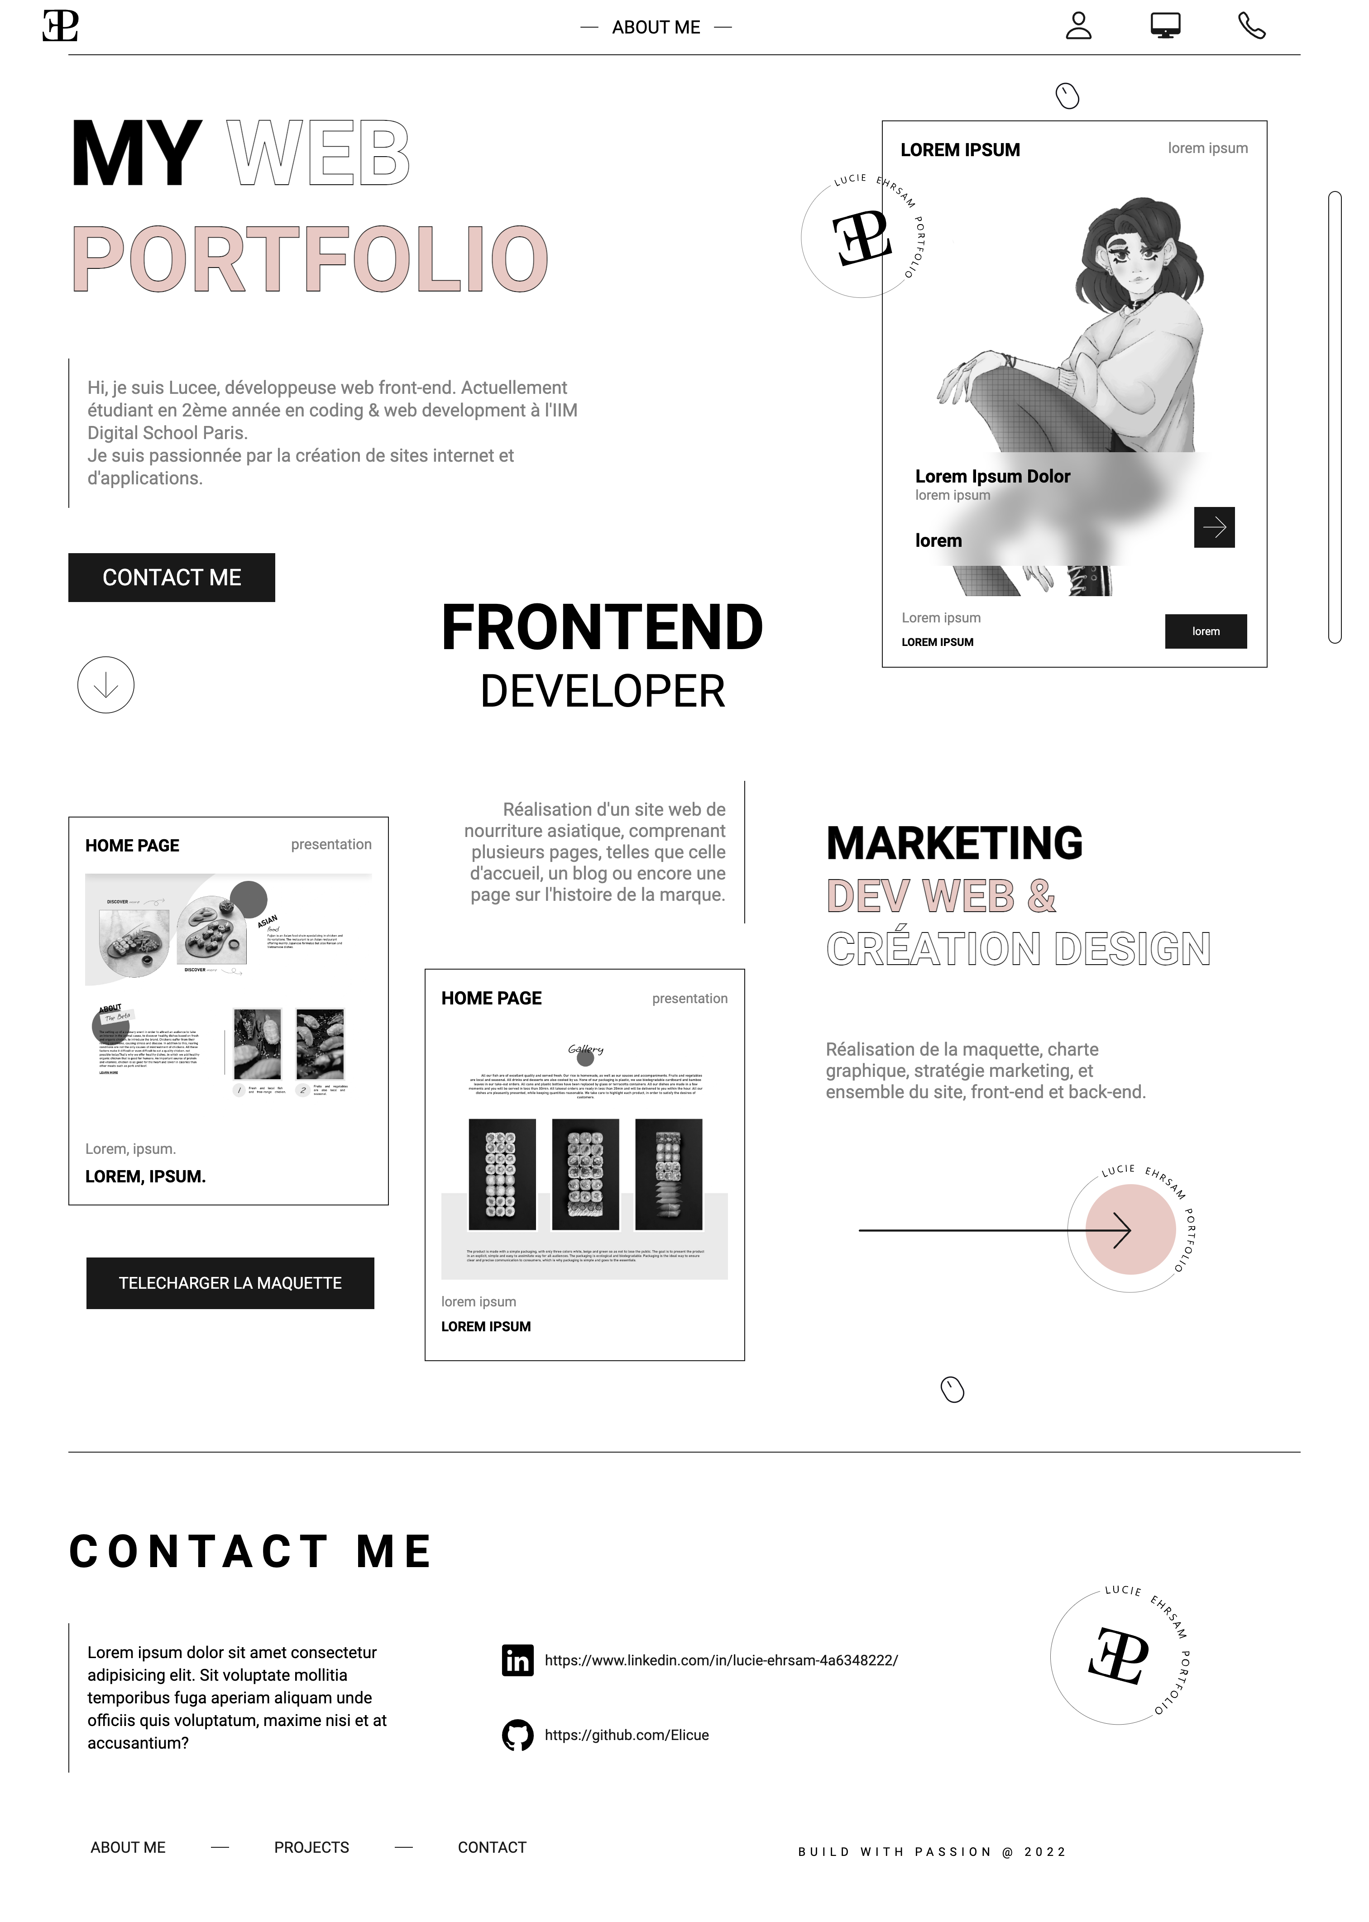
Le Site
Mercury is the closest planet to the Sun and the smallest one in the entire Solar System. This planet's name has nothing to do with the liquid metal, since Mercury was named after the Roman messenger god. Despite being closer to the Sun than Venus, its temperatures aren't as terribly hot as that planet's. Its surface is quite similar to that of Earth's Moon
Speaking of craters, many of them were named after artists or authors who made significant contributions to their respective fields. Mercury takes a little more than 58 days to complete its rotation, so try to imagine how long days must be there! Since the temperatures are so extreme, albeit not as extreme as in Venus, and the solar radiation is so high, Mercury has been deemed to be non-habitable for humans

Slide 5
Contents of this template
You can delete this slide when you’re done editing the presentation
Fonts | To view this template correctly in PowerPoint, download and install the fonts we used
Used and alternative resources | An assortment of graphic resources that are suitable for use in this presentation
Thanks slide | You must keep it so that proper credits for our design are given
Colors | All the colors used in this presentation
Icons and infographic resources | These can be used in the template, and their size and color can be edited
Editable presentation theme | You can edit the master slides easily. For more info, click here
For more info: SLIDESGO | SLIDESGO SCHOOL | FAQs
You can visit our sister projects: FREEPIK | FLATICON | STORYSET | WEPIK | VIDEVO

Slide 6
—Someone Famous
“This is a quote, words full of wisdom that someone important said and can make the reader get inspired.”

Slide 7
Maybe you need to divide the content
Jupiter and Mars
Venus and Mercury
Jupiter is a gas giant and the biggest planet in the Solar System. It's the fourth-brightest object in the night sky. It was named after the Roman god of the skies and lightning
Despite being red, Mars is actually a cold place. It's full of iron oxide dust
Venus has a beautiful name and is the second planet from the Sun. It’s terribly hot, even hotter than Mercury, and its atmosphere is extremely poisonous
Mercury is the closest planet to the Sun and the smallest one in the Solar System

Slide 8

You can use bullet points
Venus has a beautiful name and is the second planet from the Sun. It’s terribly hot, even hotter than Mercury, and its atmosphere is extremely poisonous. It’s the second-brightest natural object in the night sky after the Moon
Earth is the third planet from the Sun and the only one that harbors life in the Solar System. We all live on it!
Jupiter is a gas giant and the biggest planet in the Solar System. It's the fourth-brightest object in the night sky. It was named after the Roman god of the skies and lightning
Mercury is the smallest planet in the Solar System. It was named after the Roman messenger god
Despite being red, Mars is actually a cold place. It's full of iron oxide dust, which gives the planet its reddish cast

Slide 9
Infographics are always useful
01
02
03
04
Venus
Mars
Mercury is the smallest planet in the Solar System
Despite being red, Mars is a very cold place
Mercury
Jupiter
Venus is the second planet from the Sun
Jupiter is the biggest planet in the Solar System

Slide 10
A picture is worth a thousand words

Slide 11
Slide with longer text
Mercury is the closest planet to the Sun and the smallest of them all. This planet's name has nothing to do with the liquid metal, since Mercury was named after the Roman messenger god. Despite being closer to the Sun than Venus, its temperatures aren't as terribly hot as that planet's. Its surface is quite similar to that of Earth's Moon, which means there are a lot of craters and plains. Speaking of craters, many of them were named after artists or authors who made significant contributions to their respective fields. Mercury takes a little more than 58 days to complete its rotation, so try to imagine how long days must be there! Since the temperatures are so extreme, albeit not as extreme as in Venus, and the solar radiation is so high, Mercury has been deemed to be non-habitable for humans
Mercury is the closest planet to the Sun and the smallest of them all. This planet's name has nothing to do with the liquid metal, since Mercury was named after the Roman messenger god. Despite being closer to the Sun than Venus, its temperatures aren't as terribly hot as that planet's. Its surface is quite similar to that of Earth's Moon, which means there are a lot of craters and plains. Speaking of craters, many of them were named after artists or authors who made significant contributions to their respective fields. Mercury takes a little more than 58 days to complete its rotation, so try to imagine how long days must be there! Since the temperatures are so extreme, albeit not as extreme as in Venus, and the solar radiation is so high, Mercury has been deemed to be non-habitable for humans

Slide 12
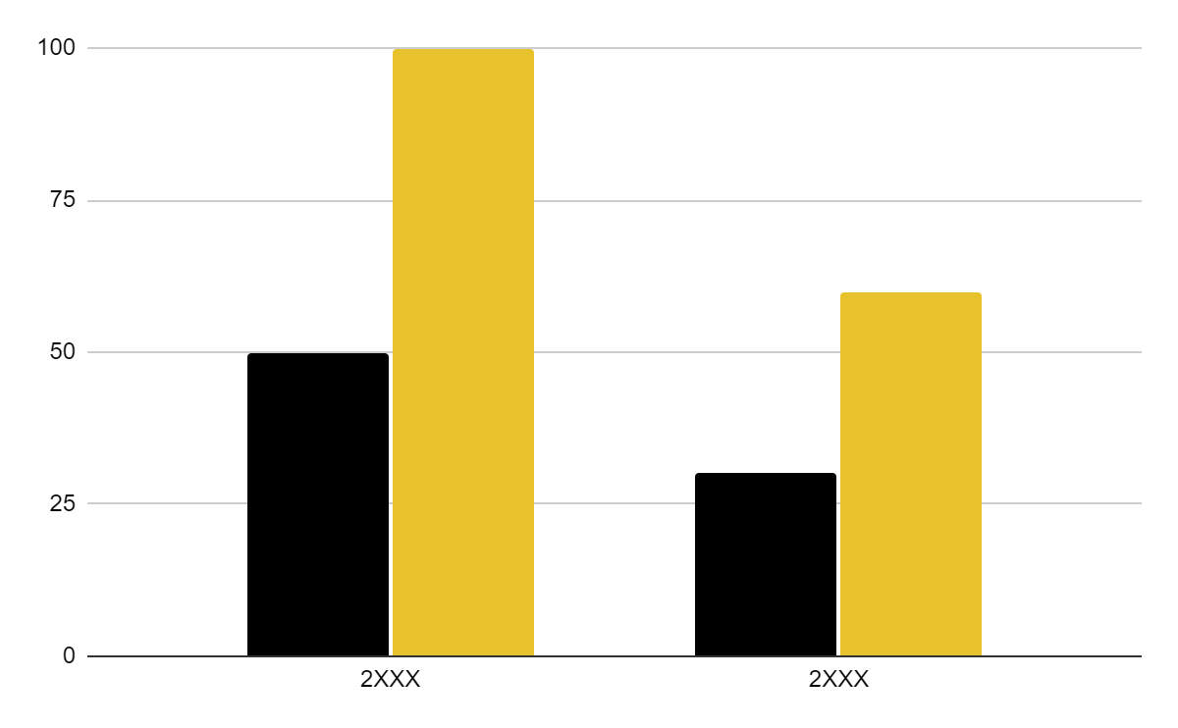
You can use this graph
Mercury
Jupiter
Mercury is the smallest planet of them all
Jupiter is the biggest planet of them all
Follow the link in the graph to modify its data and then paste the new one here. For more info, click here

Slide 13
Thanks!
Do you have any questions?
youremail@freepik.com
+34 654 321 432
yourwebsite.com
Please keep this slide for attribution

Slide 14
Alternative resources
Here’s an assortment of alternative resources whose style fits that of this template:

Slide 15
Resources
Did you like the resources on this template? Get them for free at our other websites:
Vectors
Lifestyle instagram post design template
Photos
Colleagues doing team work for a project I
Colleagues doing team work for a project II
Business woman banner concept with copy space

Slide 16
Instructions for use
If you have a free account, in order to use this template, you must credit Slidesgo by keeping the Thanks slide. Please refer to the next slide to read the instructions for premium users.
As a Free user, you are allowed to:
Modify this template.
Use it for both personal and commercial projects.
You are not allowed to:
Sublicense, sell or rent any of Slidesgo Content (or a modified version of Slidesgo Content).
Distribute Slidesgo Content unless it has been expressly authorized by Slidesgo.
Include Slidesgo Content in an online or offline database or file.
Offer Slidesgo templates (or modified versions of Slidesgo templates) for download.
Acquire the copyright of Slidesgo Content.
For more information about editing slides, please read our FAQs or visit Slidesgo School:
https://slidesgo.com/faqs and https://slidesgo.com/slidesgo-school

Slide 17
Instructions for use (premium users)
As a Premium user, you can use this template without attributing Slidesgo or keeping the Thanks slide.
You are allowed to:
Modify this template.
Use it for both personal and commercial purposes.
Hide or delete the “Thanks” slide and the mention to Slidesgo in the credits.
Share this template in an editable format with people who are not part of your team.
You are not allowed to:
Sublicense, sell or rent this Slidesgo Template (or a modified version of this Slidesgo Template).
Distribute this Slidesgo Template (or a modified version of this Slidesgo Template) or include it in a database or in any other product or service that offers downloadable images, icons or presentations that may be subject to distribution or resale.
Use any of the elements that are part of this Slidesgo Template in an isolated and separated way from this Template.
Register any of the elements that are part of this template as a trademark or logo, or register it as a work in an intellectual property registry or similar.
For more information about editing slides, please read our FAQs or visit Slidesgo School:
https://slidesgo.com/faqs and https://slidesgo.com/slidesgo-school

Slide 18
Fonts & colors used
This presentation has been made using the following fonts:
Playfair Display
(https://fonts.google.com/specimen/Playfair+Display)
Roboto
(https://fonts.google.com/specimen/Roboto)
#000000
#f0f0f0
#e7c22c
#ffffff

Slide 19





Storyset
Create your Story with our illustrated concepts. Choose the style you like the most, edit its colors, pick the background and layers you want to show and bring them to life with the animator panel! It will boost your presentation. Check out how it works.
Pana
Amico
Bro
Rafiki
Cuate

Slide 20
Use our editable graphic resources...
You can easily resize these resources without losing quality. To change the color, just ungroup the resource and click on the object you want to change. Then, click on the paint bucket and select the color you want. Group the resource again when you’re done. You can also look for more infographics on Slidesgo.

Slide 23
JANUARY
FEBRUARY
MARCH
APRIL
MAY
JUNE
PHASE 1
Task 1
Task 2
PHASE 2
Task 1
Task 2
JANUARY
FEBRUARY
MARCH
APRIL
PHASE 1
Task 1
Task 2

Slide 26
...and our sets of editable icons
You can resize these icons without losing quality.
You can change the stroke and fill color; just select the icon and click on the paint bucket/pen.
In Google Slides, you can also use Flaticon’s extension, allowing you to customize and add even more icons.

Slide 27
Educational Icons
Medical Icons

Slide 28
Business Icons
Teamwork Icons

Slide 29
Help & Support Icons
Avatar Icons

Slide 30
Creative Process Icons
Performing Arts Icons

Slide 31
Nature Icons

Slide 32
SEO & Marketing Icons

Slide 33


